Slide 2
Introduction

Slide 3
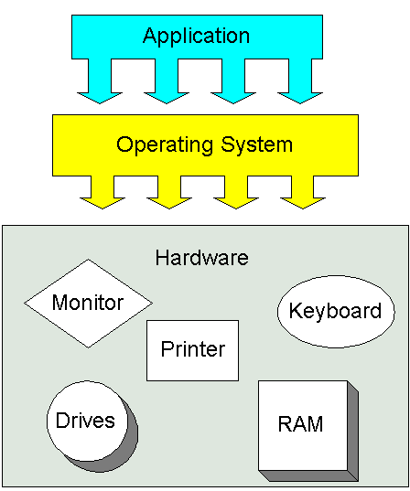

Introduction to OS
What is an Operating System?
An operating system (OS) is system software that manages computer hardware and software resources and provides common services for computer programs.

Slide 4
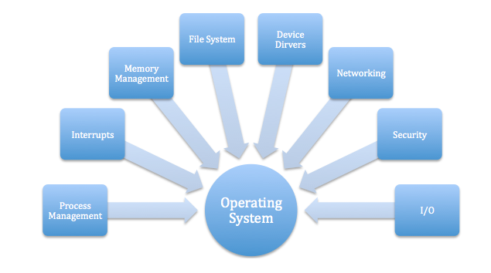
Why we need operating system

Slide 5
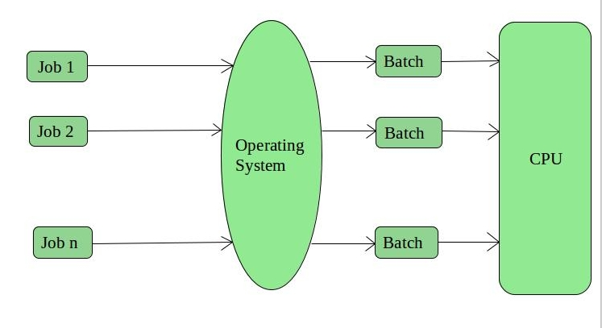
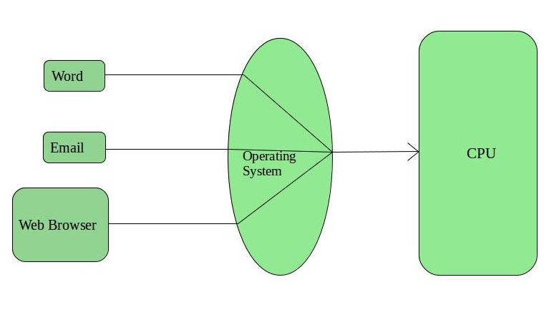
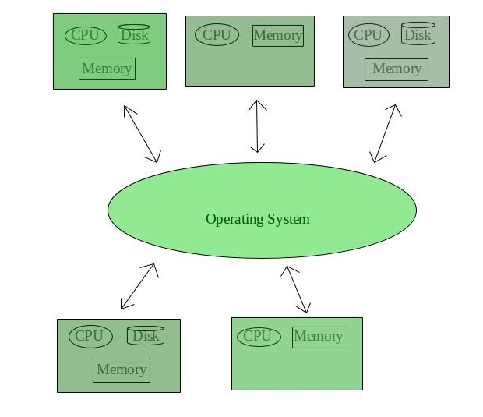
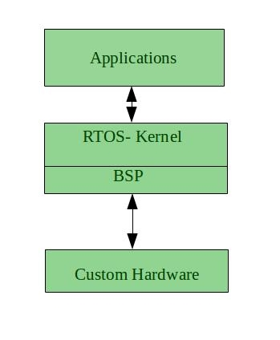
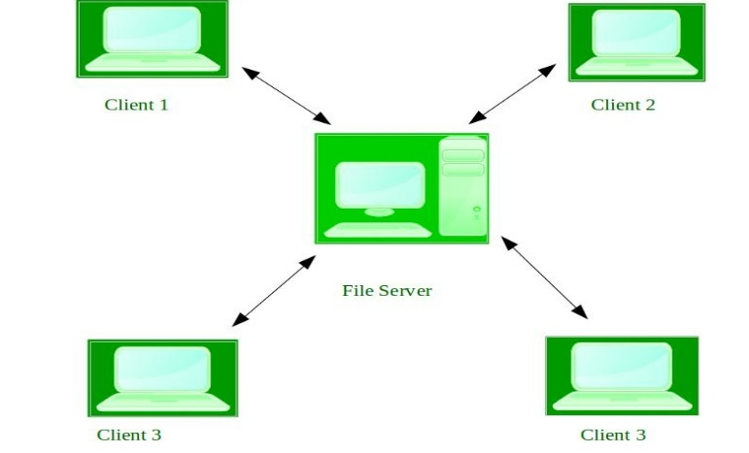
Types of Operating Systems
1. Batch Operating System
2. Time-Sharing Operating Systems
5. Real-Time Operating System
3. Distributed Operating System
4. Network Operating System

Slide 6
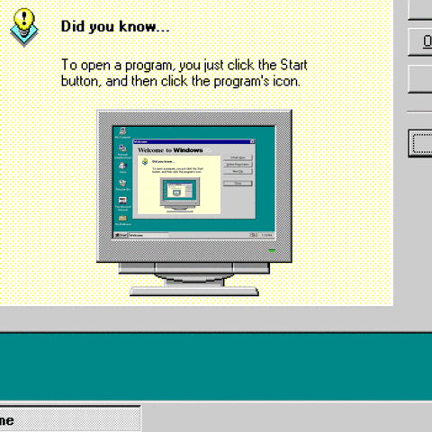
What is Windows OS?
Developed by Microsoft.
Each version of Windows includes a graphical user interface, with a desktop that allows users to view files and folders in windows.
Designed for both home computing and professional purposes.

Slide 7
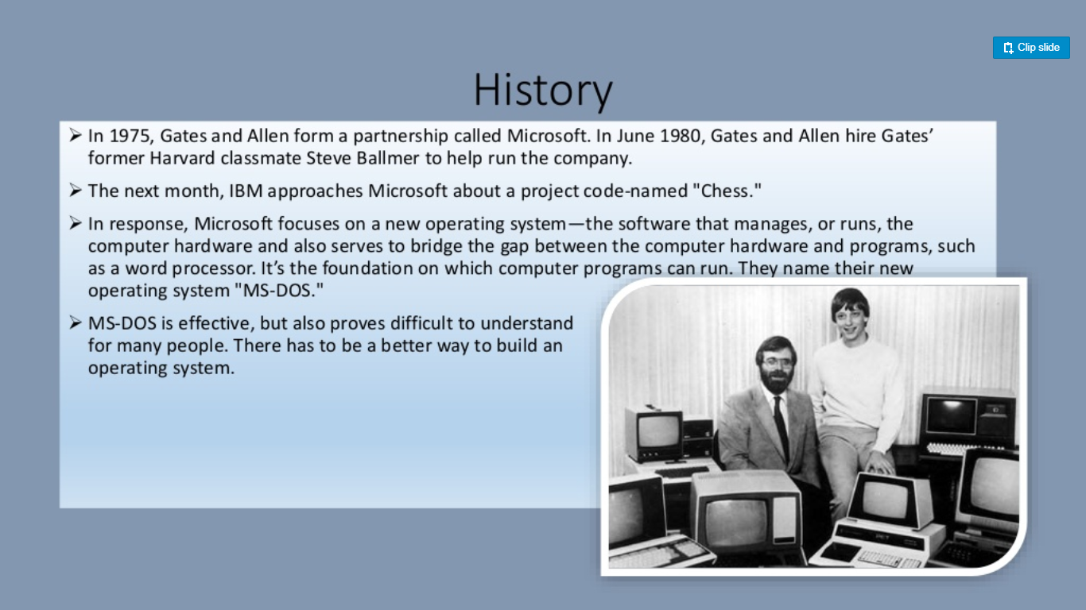

Slide 8

Pros and Cons of Windows OS
Not strong enough for high security.
Are buggy.
Windows series are big.
Windows ME and earlier 9x versions are unstable and insecure.
Source codes of Windows are closed, owned by Microsoft
Wide spread.
Not very expensive.
Supported by most popular softwares.
Windows NT series after 2004 are stabler and securer.

Slide 9
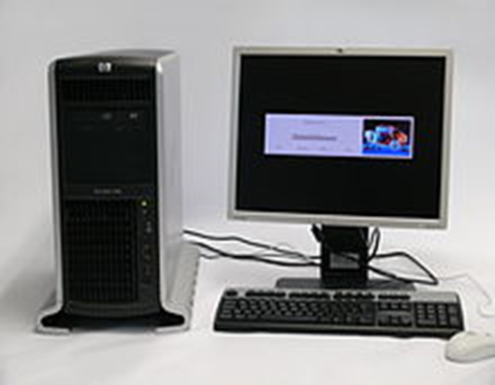
WORKSTATION SERVER
A workstation is a special computer designed for technical or scientific applications.
Intended primarily to be used by one person at a time, they are commonly connected to a local area network and run multi-user operating systems.
Workstations offers higher performance than mainstream personal computers, especially with respect to CPU and graphics, memory capacity,
and multitasking capability.

Slide 10

What is windows server OS?
Microsoft Windows Server OS (operating system) is a series of enterprise-class server operating systems designed to share services with multiple users and provide extensive administrative control of data storage, applications and corporate networks.
Development for Windows Server started in the early 1980s
Microsoft engineer David Cutler developed the kernel of Windows NT with the intent to provide speed, security and reliability that large organizations require in a server operating system.

Slide 11
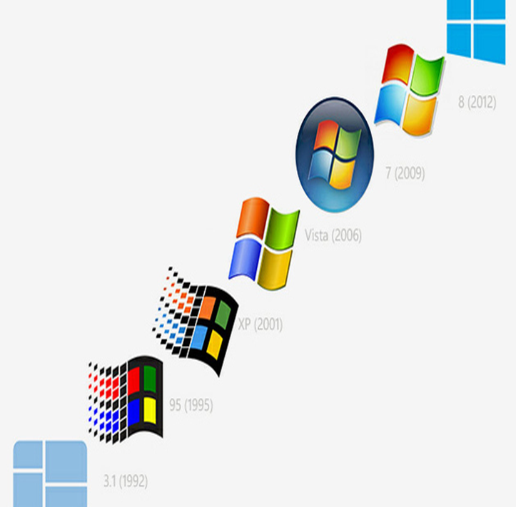
Versions of Workstation
Windows NT 3.1 1993
Windows NT 3.5 1994
Windows NT 3.51 1995
Windows NT 4.0 1996
Windows 2000 1999
Windows XP 2001
Windows Vista 2006
Windows 7 2009
Windows 8 2012
Windows 8.1 2013
Windows 10 2015

Slide 12
Features
Windows 7
Start menu
Taskbar and Notification area
Windows Snipping Tool
Displaying to a External Monitor or Projector
Using LAN
Windows explorer libraries
Windows server 2008 R2
Server Core.
Active Directory roles.
Failover Clustering.
Self-healing NTFS.
Hyper-V.
Windows System Resource Manager.
Server Manager.

Slide 13
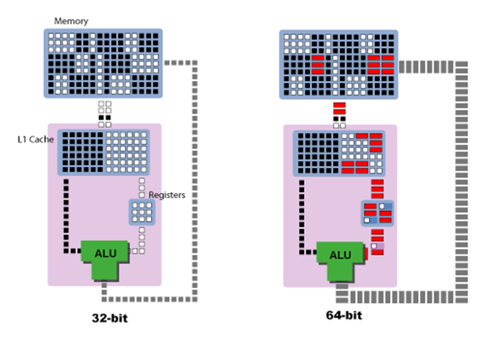
32-bit vs 64-bit
 | 32-bit | 64-bit
Memory storage | 4GB | 128gb
Addresses | 2^32 | 2^64
Speed | Slow | Fast
Compatibility | Not possible | Possible
Cost | Less | More
Examples | Windows 95, 98, NT, 2000, XP, Vista. | Windows 7,8,8.1, 10

Slide 14
Windows Kernel

Slide 15
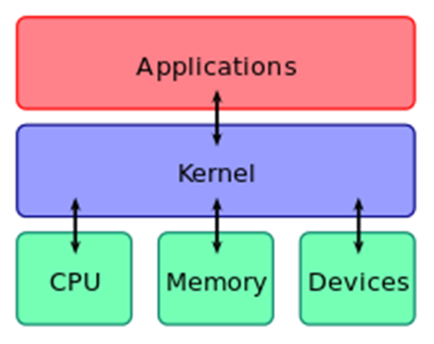
Kernel
It is a computer program, which have complete control over all other programs in the system.
Central module of operating system.
Connects the application software to the system hardware.

Slide 16
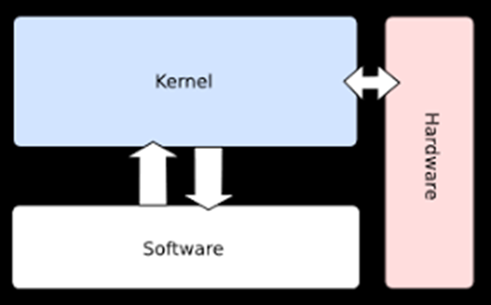
Monolithic Kernel
One single program that contains all of the code necessary to perform every kernel related task.
Deals with the system services like process management, device management, Interrupt handling, file system etc.,
Acts as an interface between the hardware and software.
Faster execution because no queue process.

Slide 17
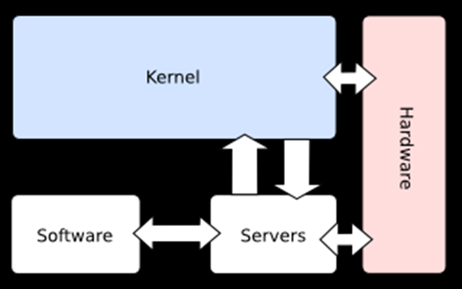
Micro Kernel
Deals with basic scheduler, basic memory handling, basic I/O primitives
The microkernel design allows for easier management of code due to its division into user space services.
This also allows for increased security and stability resulting from the reduced amount of code running in kernel mode.

Slide 18
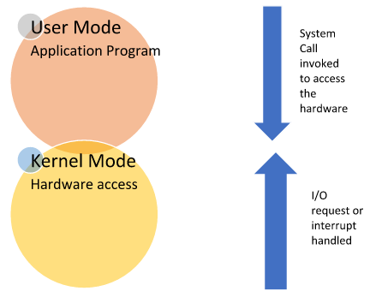
Modes of Kernel
User Mode
Kernel Mode

Slide 19
User Mode
Mode in which the computer application runs.
When the process is in user mode and requires any hardware resource, that request is sent to the kernel.
Limited access to hardware.
Also called as less privileged mode, slave mode or restricted mode.

Slide 20
Kernel mode
Also called as System mode or Privileged mode.
A kernel is a software program which is used to access hardware components of a computer system.
When the process is executing in user mode and if that process requires hardware resources such as RAM, printer etc, that process should send a request to the kernel.
Then the computer enters Kernel Mode from user mode.

Slide 21
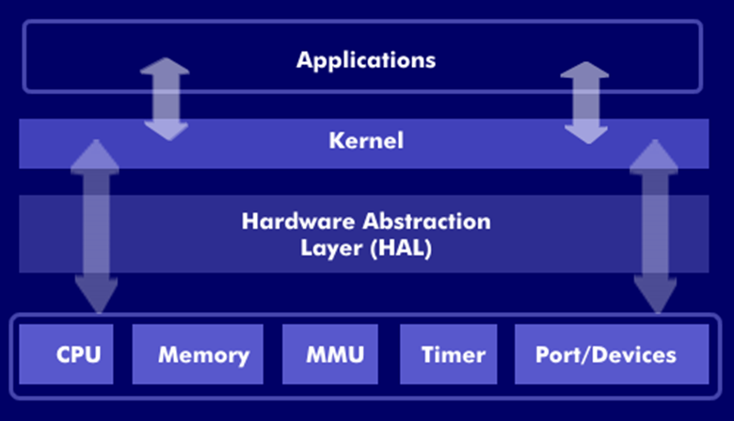
Kernel Components
1.HAL
2.Executive services
Hardware Abstraction layer
Isolates kernel from hardware variations.
It consists of a series of functions that hides or abstract the differences between hardware platforms.

Slide 22

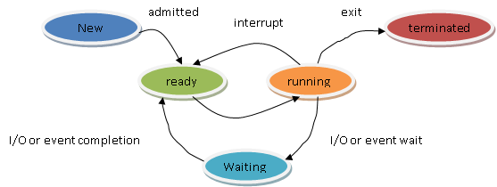
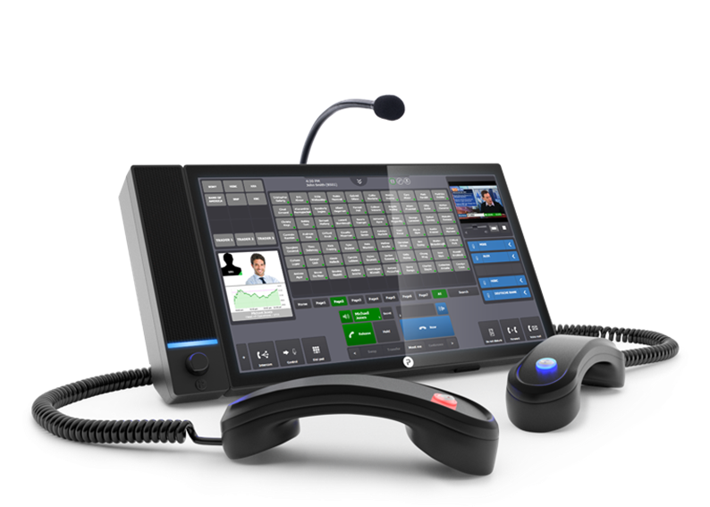


2. Executive Services
Security Reference Monitor
Process Control Block
Local Procedure Call
Plug and Play Manager
Configuration Manager

